Slide 1

Introduction
Comparisons
Neural Networks
PyTorch to build a simple neural network
  Import
  Activation
  Data
  Hands on “Actual task for exercise 1”
  Stack them up
  Solution

Slide 2
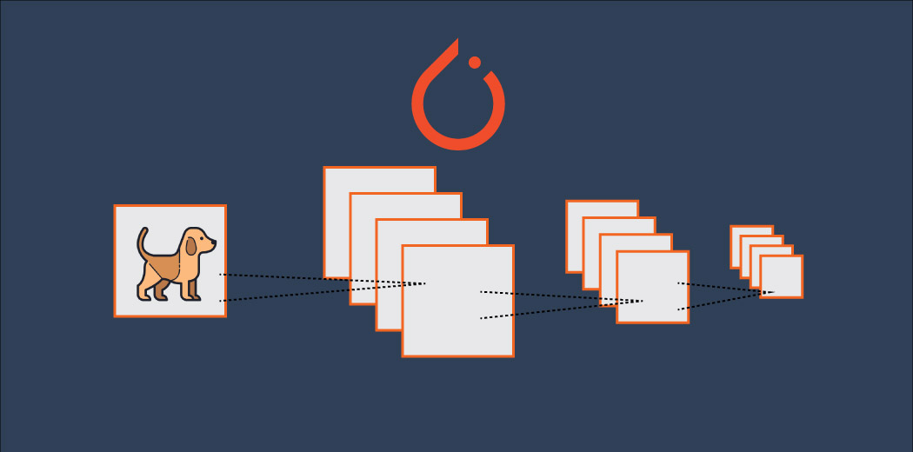
Introduction
PyTorch is a framework for building and training neural networks.

Slide 3
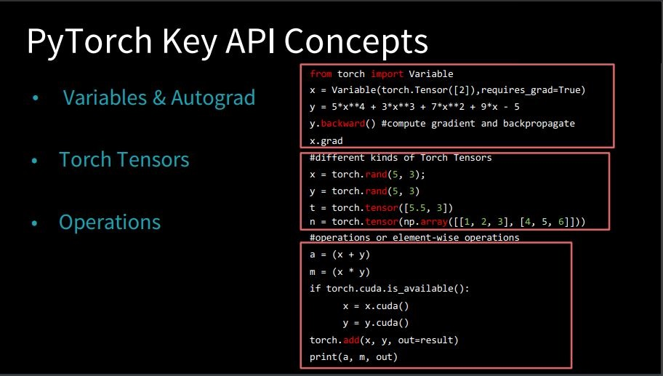

Slide 4

PyTorch in a lot of ways behaves like the arrays you love from Numpy. These Numpy arrays, after all, are just tensors.

Slide 5
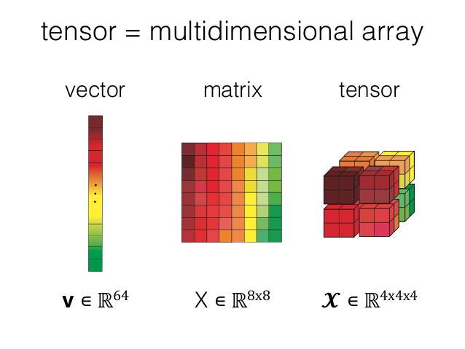
Tensors can also be used on a GPU to accelerate computing
PyTorch supports various types of Tensors:
  32-bit (Float + Int)
  64-bit (Float + Int)
  16-bit (Float + Int)
  8-bit (Signed + Unsigned)
Note: Be careful when working with different Tensor Types to avoid type errors

Slide 6


PyTorch takes these tensors and makes it simple to move them to GPUs for the faster processing needed when training neural networks.

Slide 7

All together, PyTorch ends up being more coherent with Python and the Numpy/Scipy stack compared to TensorFlow and other frameworks.
Pytorch also provides a module that automatically calculates gradients (for backpropagation!) and another module specifically for building neural networks.

Slide 8
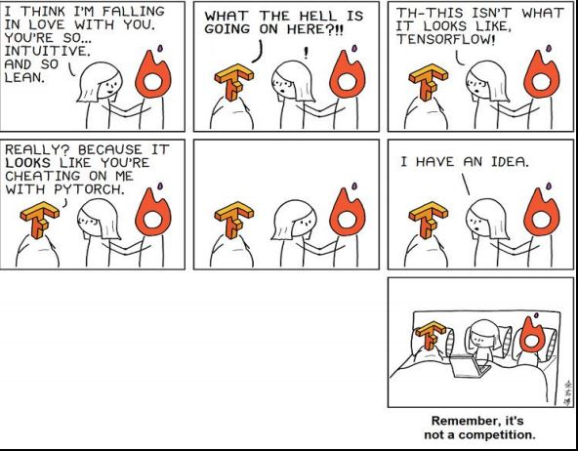
Comparison

Slide 9
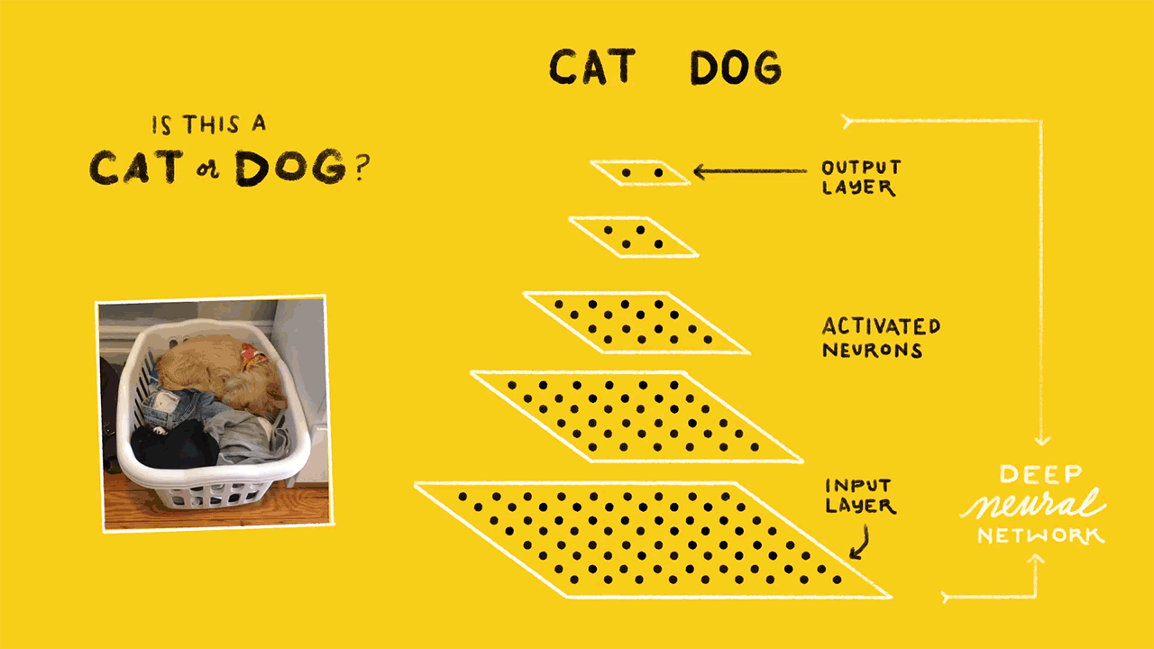
Neural Networks
It turns out neural network computations are just a bunch of linear algebra operations on tensors, a generalization of matrices
The fundamental data structure for neural networks are tensors and PyTorch (as well as pretty much every other deep learning framework) is built around tensors.

Slide 10
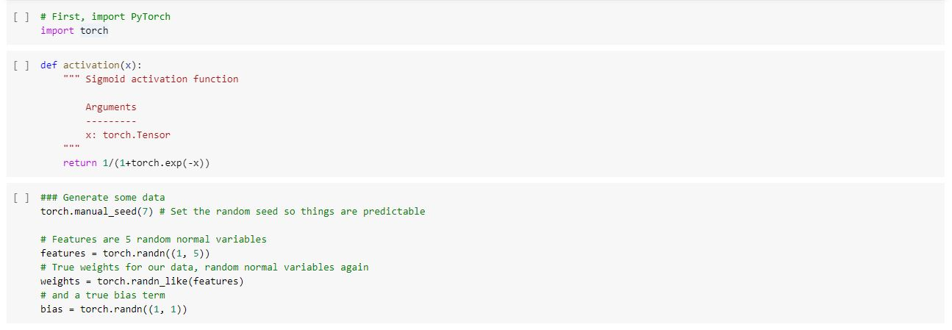
PyTorch to build a simple neural network
Pip install PyTorch (not req in Colab)
The activation function is an essential building block for every neural network.
We can choose from a huge list of popular activation functions from popular Deep Learning frameworks, like ReLU, Sigmoid, Tanh, and many others.
Data is generated to be used to to get the output of our simple network.
features = torch.randn((1, 5)) creates a tensor with shape (1, 5), one row and five columns, that contains values randomly distributed according to the normal distribution with a mean of zero and standard deviation of one.
weights = torch.randn_like(features) creates another tensor with the same shape as features, again containing values from a normal distribution.
Finally, bias = torch.randn((1, 1)) creates a single value from a normal distribution.

Slide 11
Sub exercise 1
Calculate the output of this network using the weights and bias tensors

Slide 12
Sub exercise 2
Calculate the output of our little network using matrix multiplication

Slide 13
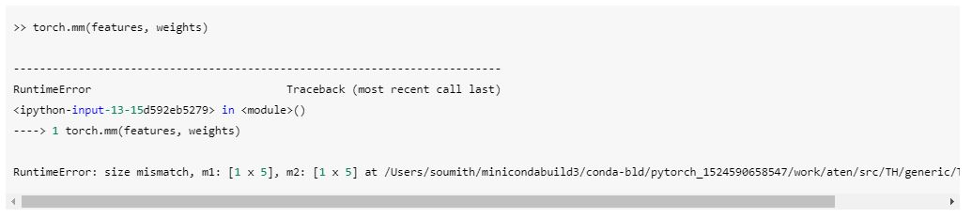
Error
As you're building neural networks in any framework, you'll see this often. Really often. What's happening here is our tensors aren't the correct shapes to perform a matrix multiplication. Remember that for matrix multiplications, the number of columns in the first tensor must equal to the number of rows in the second column. Both features and weights have the same shape, (1, 5). This means we need to change the shape of weights to get the matrix multiplication to work.
Note: To see the shape of a tensor called tensor, use tensor.shape. If you're building neural networks, you'll be using this method often.

Slide 14
Solution
There are a few options here: weights.reshape(), weights.resize_(), and weights.view().
weights.reshape(a, b) will return a new tensor with the same data as weights with size (a, b) sometimes, and sometimes a clone, as in it copies the data to another part of memory.
weights.resize_(a, b) returns the same tensor with a different shape. However, if the new shape results in fewer elements than the original tensor, some elements will be removed from the tensor (but not from memory). If the new shape results in more elements than the original tensor, new elements will be uninitialized in memory. Here I should note that the underscore at the end of the method denotes that this method is performed in-place. Here is a great forum thread to read more about in-place operations in PyTorch.
weights.view(a, b) will return a new tensor with the same data as weights with size (a, b).
I usually use .view(), but any of the three methods will work for this. So, now we can reshape weights to have five rows and one column with something like weights.view(5, 1).

Slide 15
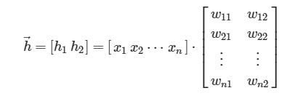

Stack them up
That's how you can calculate the output for a single neuron. The real power of this algorithm happens when you start stacking these individual units into layers and stacks of layers, into a network of neurons. The output of one layer of neurons becomes the input for the next layer. With multiple input units and output units, we now need to express the weights as a matrix
The first layer shown on the bottom here are the inputs, understandably called the input layer. The middle layer is called the hidden layer, and the final layer (on the right) is the output layer. We can express this network mathematically with matrices again and use matrix multiplication to get linear combinations for each unit in one operation. For example, the hidden layer ( h1 and h2 here) can be calculated
The output for this small network is found by treating the hidden layer as inputs for the output unit. The network output is expressed simply

Slide 16
Sub exercise 3
Calculate the output for this multi-layer network using the weights W1 & W2, and the biases, B1 & B2.

Slide 17
Solutions
Solution 1:
# Now, make our labels from our data and true weights
y = activation(torch.sum(features * weights) + bias)
OR
y = activation((features * weights).sum() + bias)
Solution 2:
y = activation(torch.mm(features, weights.view(5,1)) + bias)
Solution 3:
h = activation(torch.mm(features, W1) + B1)
output = activation(torch.mm(h, W2) + B2)
print(output)

Slide 18
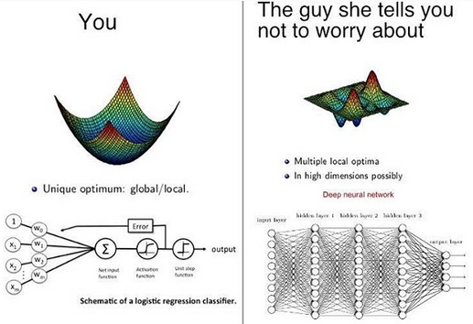

Slide 19
Thank you

